Slide 1






iTunes SQL Analytics Project

Slide 2
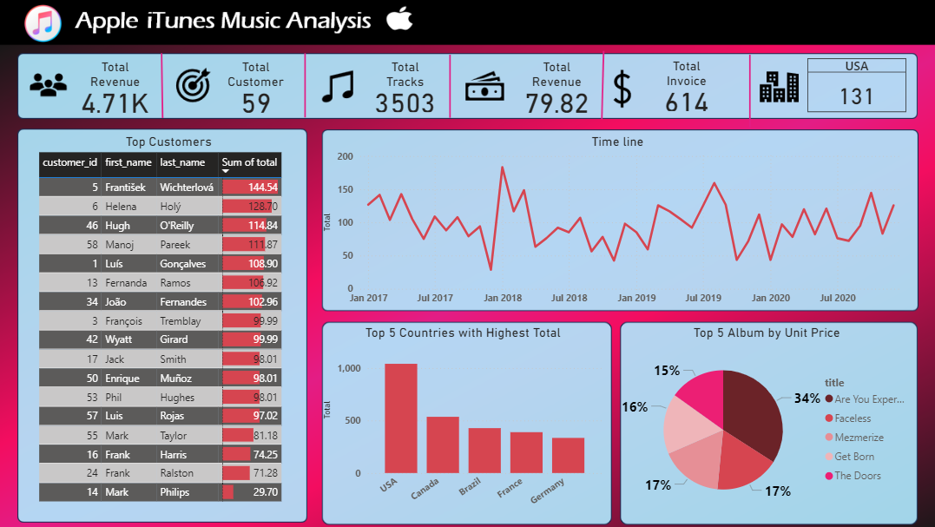
Power BI Dashboard

Slide 3
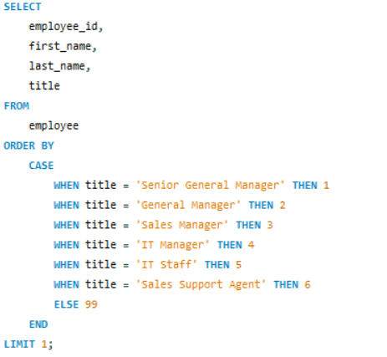

1)Who is the senior most employee based on job title?

Slide 4
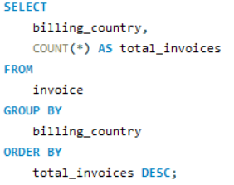
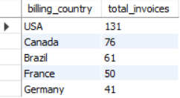
2) Which countries have the most Invoices?

Slide 5
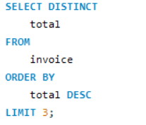

3) What are top 3 values of total invoice?

Slide 6
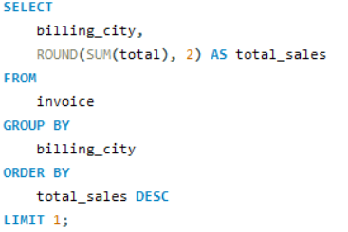

4) Which city has the best customers?

Slide 7
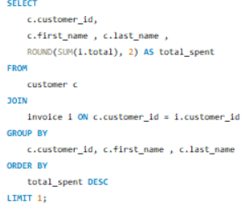

5)Who is the best customer?

Slide 8
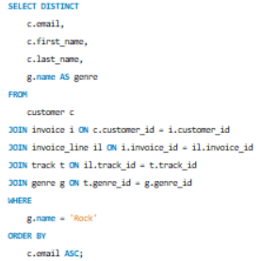
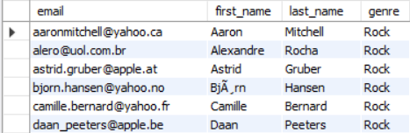
6) Write a query to return the email, first name, last name, & Genre of all Rock Music listeners. Return your list ordered alphabetically by email starting with A
To be Continued….

Slide 9
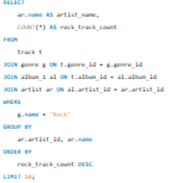
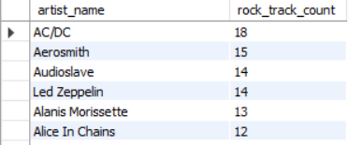
7)Top 10 Rock Artists by Track Count
To be Continued…..

Slide 10

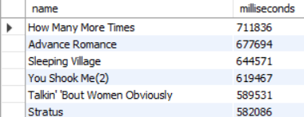
8) Tracks longer than the average song
To be Continued….

Slide 11
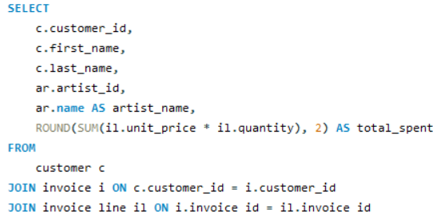
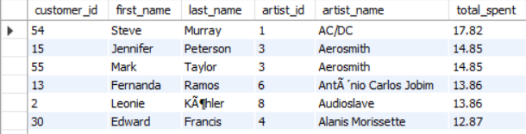
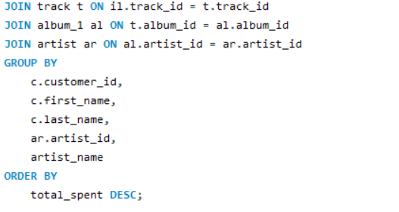
9) Total amount spent by each customer on each artist
To be Continued…

Slide 12
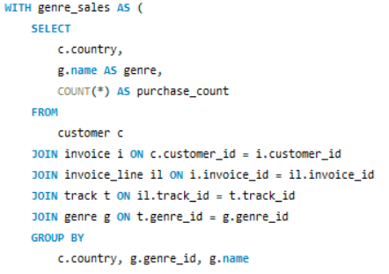
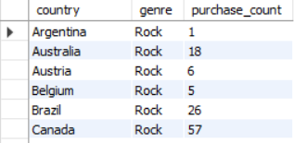
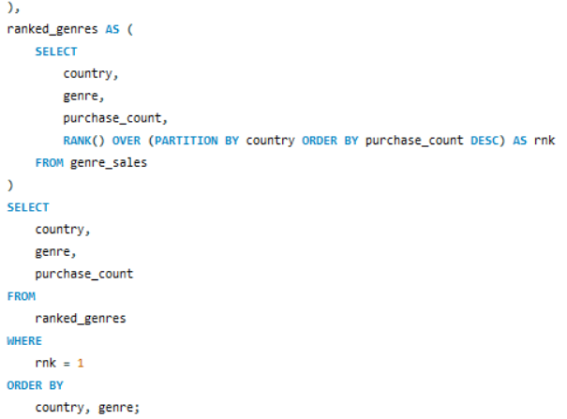
10) Most popular music genre per country
To be Continued…

Slide 13
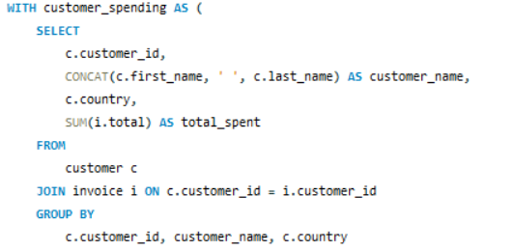
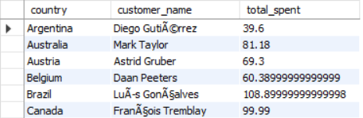
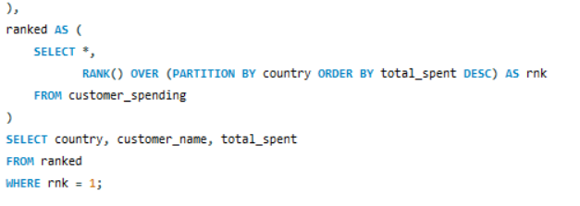
11) Top customer by spending in each country
To be Continued…..

Slide 14
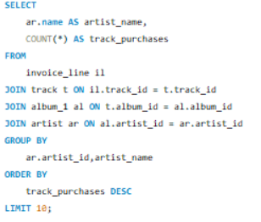
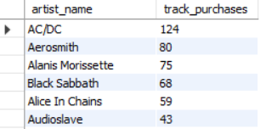
12) Most popular artists
To be Continued….

Slide 15
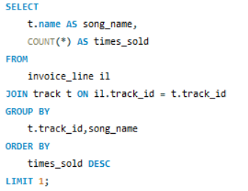

13)Most popular song

Slide 16
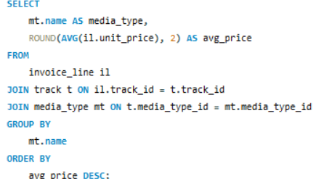

14)Average prices of different types of music

Slide 17
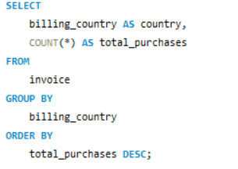
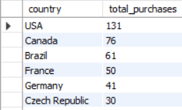
15) Most popular countries for music purchases
To be Continued….

